Slide 1
Employee Data Analysis using Excel
STUDENT NAME: POOJA N
REGISTER NO: 312211115[asunm1423312211115]
DEPARTMENT:B.COM(ACCOUNTING & FINANCE)
COLLEGE :Dr. M.G.R. Janaki college of Arts & Science for Women

Slide 2
PROJECT TITLE
Employee Performance Analysis using Excel

Slide 3


AGENDA
Problem Statement
Project Overview
End Users
Our Solution and Proposition
Dataset Description
Modelling Approach
Results and Discussion
Conclusion
3/21/2024 Annual Review

Slide 4

PROBLEM STATEMENT: A problem statement is a business document that outlines an organisation's issue and proposes a detailed solution to prevent its recurrence. Problem statements serve as important communication tools, providing insights about potential threats, fostering innovation and promoting technological development.

Slide 5

PROJECT OVERVIEW
.Employee performance analysis using excel project to develop an excel dashboard to analysis employee performance, track data , and provide insights for informed decisions on talent development and growth.

Slide 6



WHO ARE THE END USERS? Employee Employers Organisation Different industries IT sectors Senior leaderships HR Analysts

Slide 7

OUR SOLUTION AND ITS VALUE PROPOSITION: CONDITIONAL FORMATTING: Conditional formatting in Excel can be used to highlight patterns and trends in data, and to make it easier to identify specific cells. Conditional formatting makes it easy to highlight certain values or make particular cells easy to identify. This changes the appearance of a cell range based on a condition (or criteria). FILTER: Filters in Excel can be used to temporarily hide data in a table or range of cells. The FILTER function allows you to filter a range of data based on criteria you define.

Slide 8
FORMULA:
Formulas in Excel are used to perform calculations and solve problems. Formulas calculate values in a specific order. A formula always begins with an equal sign (=). Excel for the web interprets the characters that follow the equal sign as a formula.
Graph:
In simple terms, a graph is a visual element that represents data in a worksheet. You will be able to analyze the data more efficiently by looking at a graph in Excel rather than numbers in a dataset. Graphs are a common method to visually illustrate relationships in the data.
PIVOT TABLE:
A PivotTable is an interactive way to quickly summarize large amounts of data. You can use a PivotTable to analyze numerical data in detail, and answer unanticipated questions about your data. A Pivot Table is used to summarise, sort, reorganise, group, count, total or average data stored in a table. It allows us to transform columns into rows and rows into columns.

Slide 9
Dataset Description Employee Performance Data – Downloaded at KAGGLE. Totally 26 features are there but we are considering at 7 features.That features are mentioned below, Employee id- Numerical Values. First Name- Text Format. Business Unit- Text Format(BPC/ CCDR/ EW/ MSC/ NEL/ PL/ ect..). Employee Type- Text Format(Contract/ Full-Time/ Part-Time). Gender Code- Text Format(Male/ Female). Employee Rating- Numerical Values(1 to 5). Performance Level- Formula Based( VERY HIGH/ HIGH/ MEDIUM/ LOW).

Slide 10

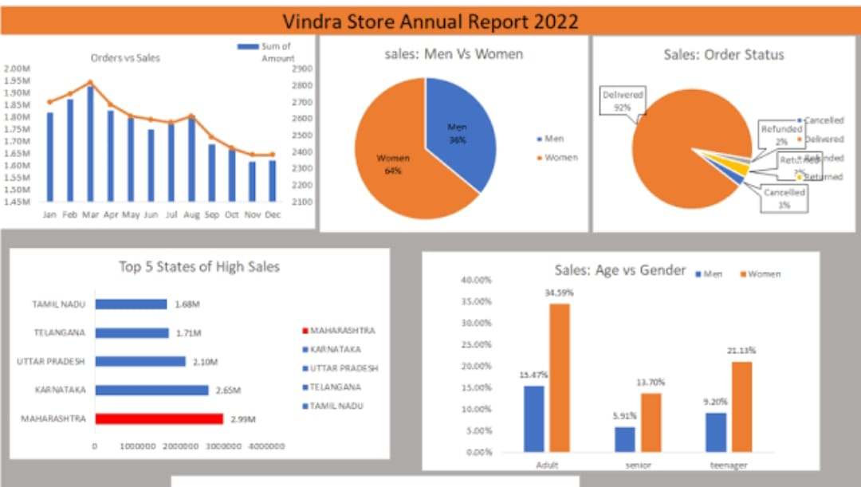
THE “WOW” IN OUR SOLUTION: Formula: =IFS(Z2>=5,”VERYHIGH”,Z2>=4,”HIGH”,Z2>=3,”MED”,TRUE,”LOW”) Pivot table:
3/21/2024 Annual Review
10

Slide 11
MODELLING
Data Collection : Employee Data set collected from Kaggle
Data cleaning : Remove extra Blank Spaces in the data
Techniques : Used Filter for removing blank columns & IF Formula for analysing the Employee Performance
Results : Creating Bar Diagram for checking the employee performance
Pivot Table : Separate the gender wise Employee Performance into 4 category as Very high, High, Medium, Low
Chart Graphs : It shows clear performance of employees
11

Slide 12
RESULTS
12

Slide 13
Conclusion This having a powerful tools that helps to me understand . This project created an excel dashboard that does just that , it: Tracks your progress , Highlights your strengths and weakneses , Helps your supervisor make informed decisions about your growth. This project can help me like; Improve skills , Get better job opportunities, Achieve career goals.

